Slide 1

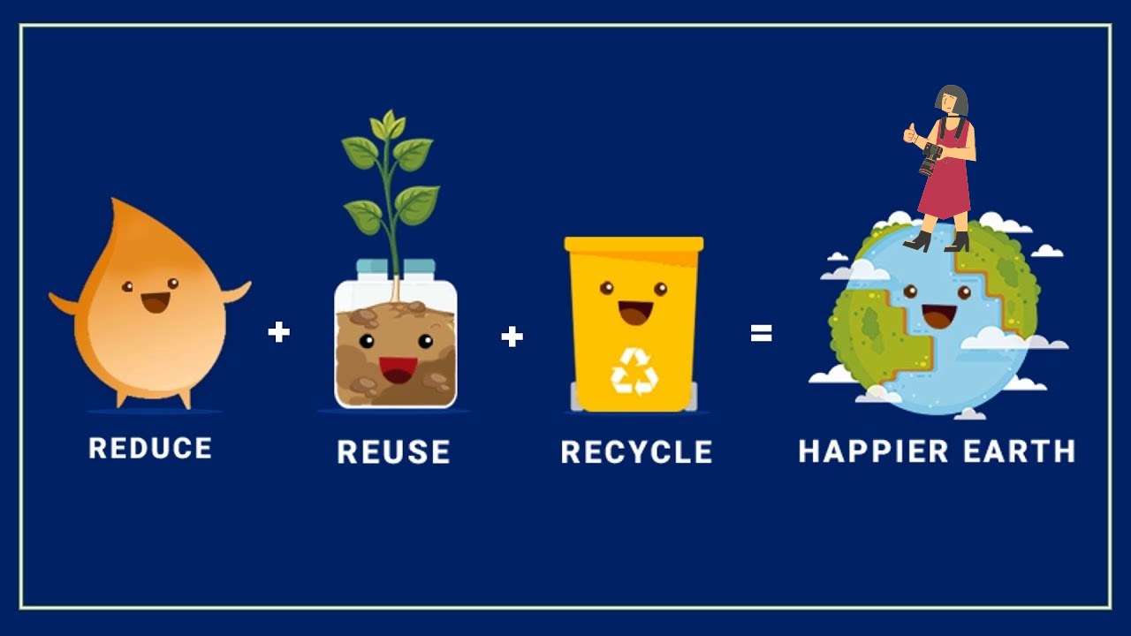
The Three Rs

Slide 2
REDUCE
Reducing is about avoiding unnecessary waste of resources and consuming fewer “throwaway” products, as they generate a lot of waste.
Using less of something to create less waste.

Slide 3
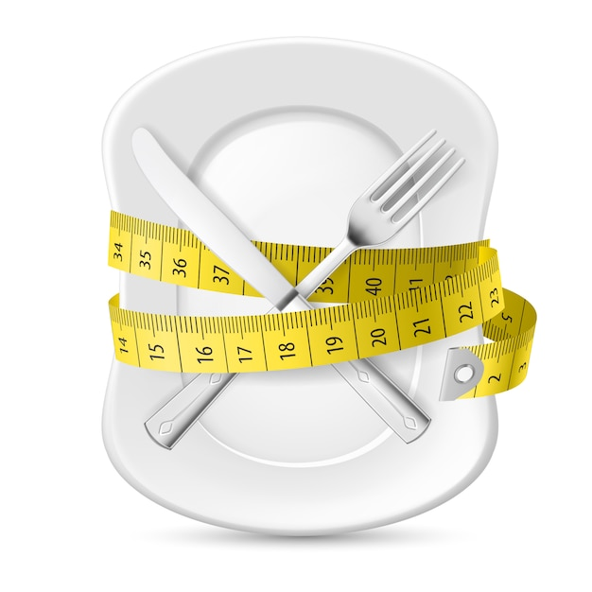


Slide 4
REUSE
To reuse is to give a second life to materials or objects before discarding them. In this way we extend their useful life and make the most of their properties.
Finding new ways to use things instead of throwing them away.

Slide 5

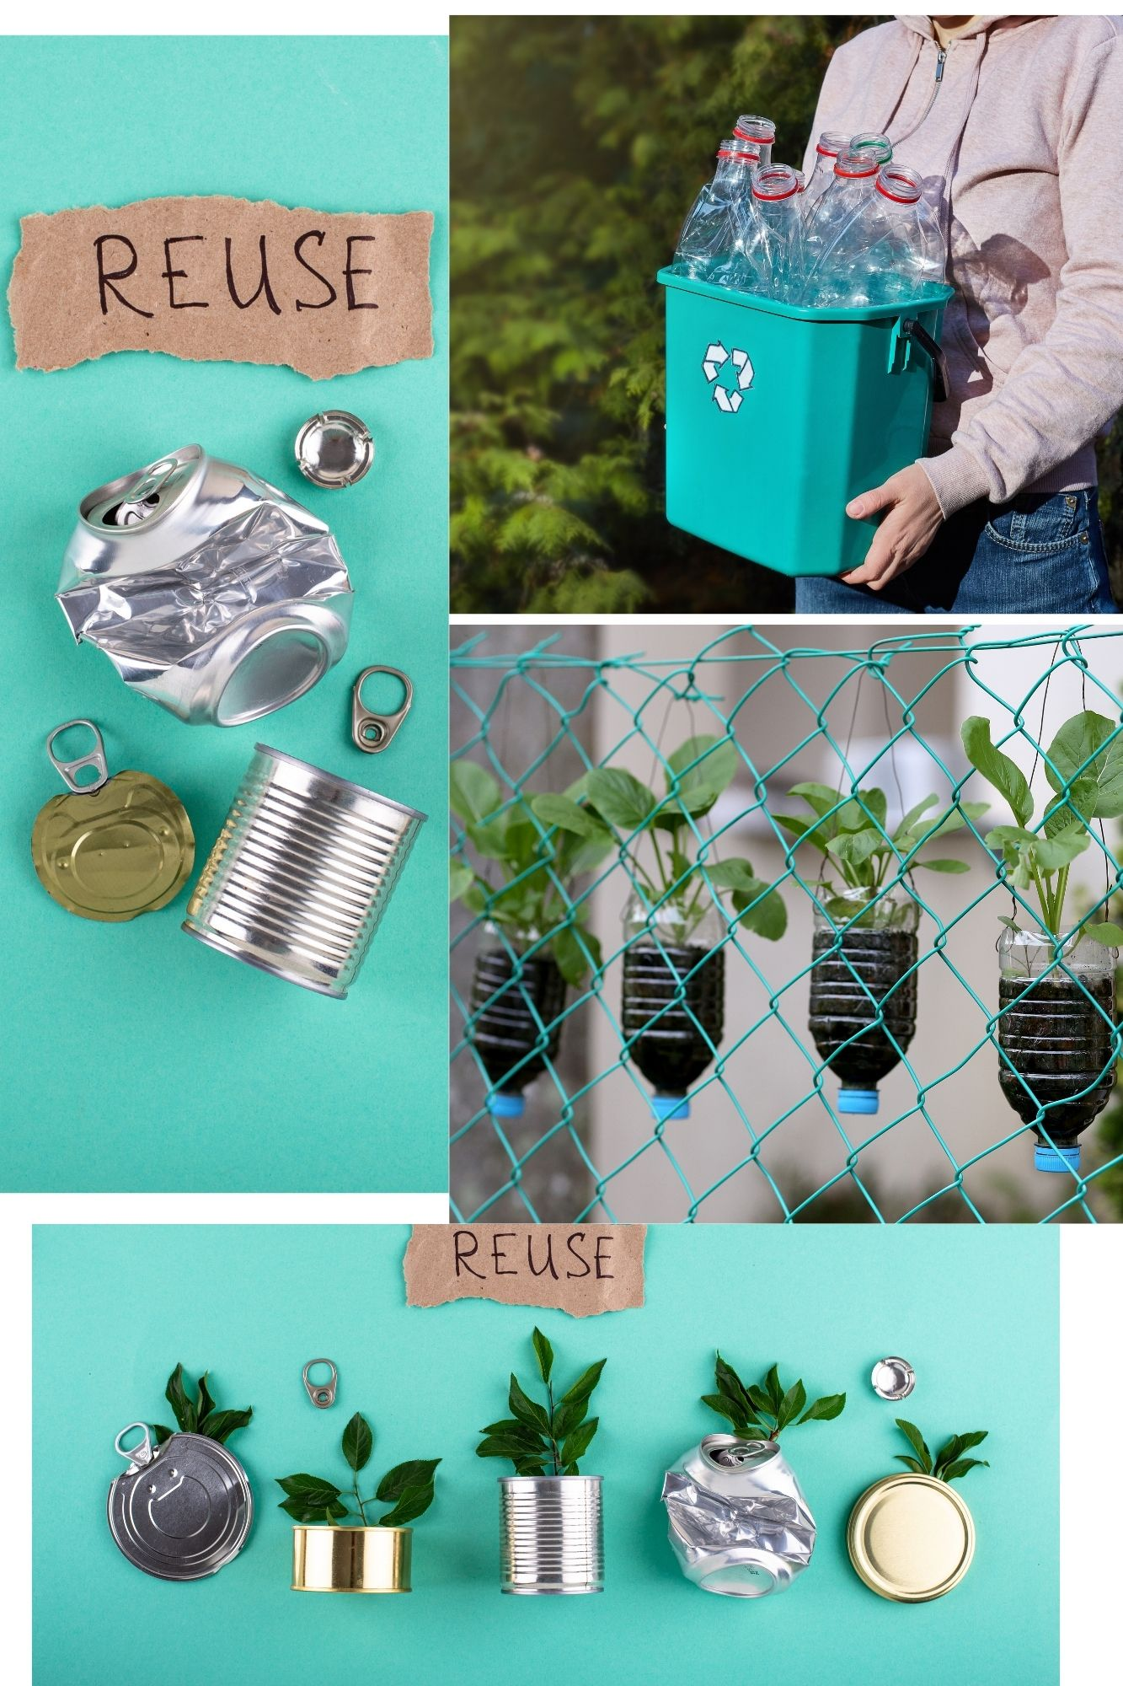

Slide 6
RECYCLE
Recycling is the action of separating the different types of waste and depositing them in the corresponding container, so that they can be used to create new products or generate new energy with them.
Turning old things into new things by processing them.

Slide 7
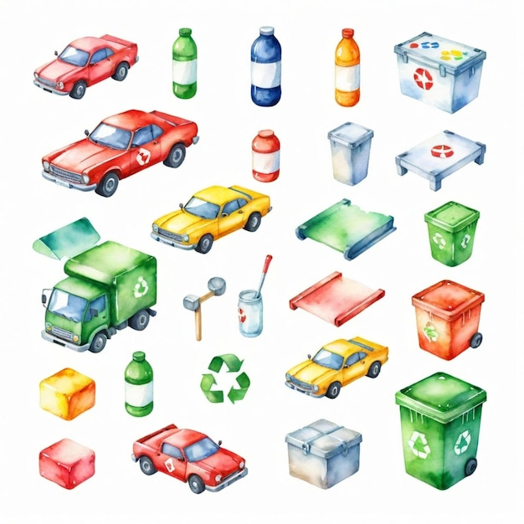


Slide 8






Module: Ecological awareness
Sub-module: Environmental pollution
Topic: The Three Rs Reduce, Reuse, Recycle
Resource title: Presentation
Credits: APDNE
2023-1-BG01-KA220-SCH-000160813
All media are within the EU intellectual property law.
Funded by the European Union. Views and opinions expressed are however those of the author(s) only and do not necessarily reflect those of the European Union or the European Education and Culture Executive Agency (EACEA). Neither the European Union nor EACEA can be held responsible for them.

